Slide 1

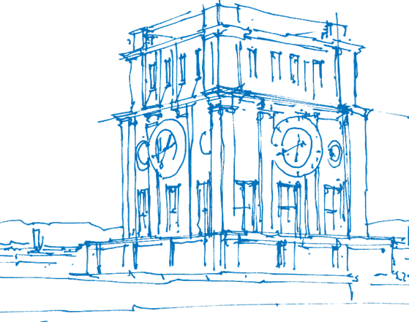
Accurate Depth Extraction from 3DGS Models
Chair of Computer Graphics and Visualization
Evelyn Regina Sidarta, 23.04.2025

Slide 2







Motivation – 3D Reconstruction
Visualization and reconstruction of 3D scenes – used to aid multiple fields, e.g. medical imaging, aerospace, aviation
NeRF (2020): accurate 3D reconstruction from collection of 2D images using neural networks
Intensive resource consumption, failure to achieve real-time display
Notes:
Neural Radiance Field Methods, suggested in 2020:
- able to reconstruct accurate 3D representation of a scene from a collection of 2D images.
- done by employing neural networks and deep learning methods
- main idea: scene is represented using a radiance field.
Method description:
- as input: collection of 2D images as mentioned before. Input contains information on camera’s viewing direction d = (\theta, \phi) and position of point in space (x, y, z)
- input transformed into continuous 5D function, fed into a MLP network. Input goes through several layers in the network to “train” the weights to calculate output
- output: color (based on the 3D location and viewing direction) and density (based on the 3D location of points in the image)
Previous methods vs. NeRF:
- Previous methods mostly output discretized voxel representations -> NeRF is more time-efficient since these voxels can be summarized with the continuous function
Limitations:
- intensive resource consumption due to usage of neural networks
- real-time rendering impossible since rendering pipeline is not yet optimized – need to recalculate the radiance field each time we change viewpoints

Slide 3

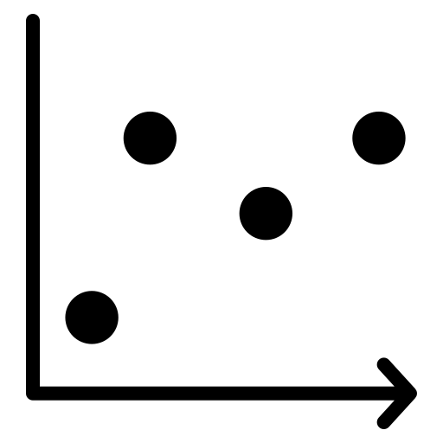

Motivation – 3D Gaussian Splatting
SfM points
3D Gaussians
optimization
rasterizer
3DGS (2023): 3D Gaussians instead of traditional meshes to reconstruct scene.
Idea: skip conversion into surface or line primitives, directly „splat“ Gaussians to paint a scenery.
Optimization: adjust distribution of Gaussians, minimize resource consumption in bland areas
Notes:
3D Gaussian Splatting
- main features: real-time rendering, combat intensive training and rendering times
- rendering fully doable on GPU
- main idea: use gaussians to represent scene instead of traditional meshes, skip conversion into surface or line primitives by directly splatting to paint a scene
- output is point cloud data: collection of 3D points that form a scene when viewed in aggregate
- During rasterization process, displayed color calculated through front-to-back alpha blending
3D Gaussians
- retain volumetric properties: color, density, transmittance
- stored: positional values, covariance matrix, opacity
Spherical harmonics: special functions on surface of a sphere

Slide 4
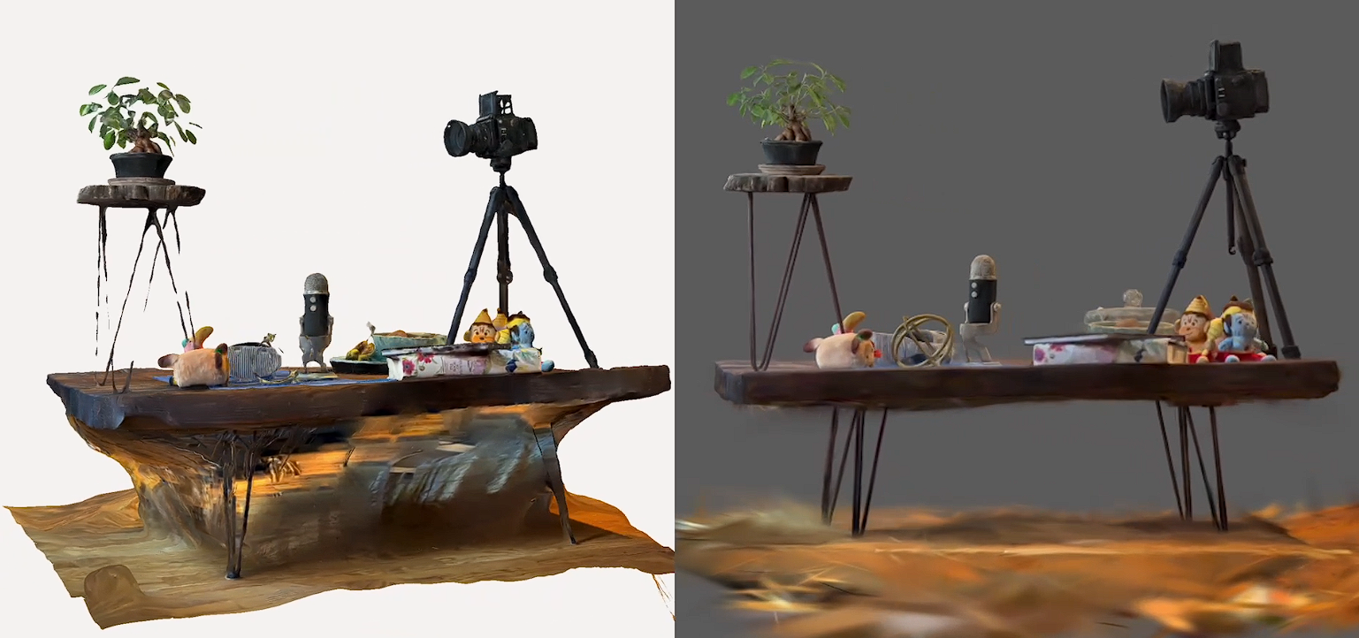
photogrammetry
vs.
3DGS

Slide 5
Motivation – 3D Gaussian Splatting
SfM points
3D Gaussians
optimization
rasterizer
Limitations: “fuzzy” representation, hard to determine geometry of the scene.
How to create accurate geometric representation?
How to identify depth accurately?
Notes:
Some other limitations:
- Noisy reconstruction – regularization techniques not yet applied
- Elongated artifacts in places where scene is not captured well
- Antialiasing techniques not yet implemented
- Training consumes a lot of resources, higher memory consumption sometimes compared to NeRF
Why depth identification is important? To extract proper geometry -> needed in tasks like object detection and simulations

Slide 6
Contribution
Review mechanisms of current available state-of-art methods for depth estimation:
MDE models vs. Gaussian Splatting derivatives
1
Provide statistical and visual comparison of select MDE and Gaussian Splatting models
2

Slide 7


Model Overview – MDE: ZoeDepth
pre-training:
encoder-decoder
Fine-tuning
Pioneering MDE model: combines Relative Depth Estimation and Metric Depth Estimation
better generalization ability, high accuracy, zero-shot capability
Notes:
Relative Depth Estimation: prediction ofdepth within a scene without providing actual scale
Metric Depth Estimation: prediction of depth in absolute units, e.g. meters
Stages:
1. Pretraining encoder-decoder model to estimate relative depth -> good generalization ability
- encoder model: process input and classify into layers, depth values classified into “bins”, transform to decoder
2. Fine-tuning on datasets with metric depth annotations -> able to achieve high accuracy conversion from relative scale to absolute scale
Zero-shot capability: able to produce accurate results for data that was not observed during training

Slide 8


Model Overview – MDE: DepthAnything v1
idea #1: use data augmentation tools to develop more complex scenarios as training materials
idea #2: use pre-trained encoders to ensure model inherits rich semantics
overall better depth estimation in broader scenarios
Notes:
Two main concepts:
1. use data augmentation tools to develop complex training scenarios: 62 million unlabeled images (large-scale monocular dataset)
- create engine to auto-label the data with correct depth annotation
- for annotation tool: 1.5 million labeled images used for training in self-learning manner
- model is trained on more complex scenarios and more difficult optimization targets
2. preexisting encoders that are trained on large datasets are used in the model
Rest of the details: similar encoder-decoder model to ZoeDepth, just more dataset and more complex initial tool

Slide 9

Model Overview – MDE: DepthAnything v2
improvement #1: synthetic data instead of labeled real images
improvement #2: improve capacity of teacher model
improvement #3: generate large amount of pseudo-labeled real images for training to enhance generality
Even more detailed depth estimation
Notes:
Three main improvements:
1. using synthetic data instead of labeled real images
- labeled data is not a good “teacher” -> often contain noise and label inaccuracies, depth map details are often overlooked
- synthetic data is extremely precise by nature, especially for harder-to-define surfaces like glass
- however: also limitations since real life data is not as “neat” and ordered as synthetic data
- there is a “distribution shift” between real data and synthetic data
- synthetic data have restricted scene coverage, e.g. real life data: photograph can contain both living room and the streets if photo from window
To alleviate issue: use training set also filled with both pseudo-labeled real images (strategy #3)
2. improve capacity of teacher model – straightforward: adopt better teacher model that is suited for training with synthetic data – DINO v2
3. use pseudo-labeled real images to bridge the gap between synthetic and real images -> used as “intermediate learning targets”

Slide 10
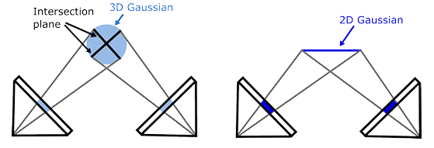
Model Overview – GS: 2DGS
main goal: multi-view accurate surface representation
3DGS: lack of accurate surface representation due to lack of explicit representation
main idea: use 2D Gaussians instead of 3D Gaussians
Notes:
2DGS
Main goal: provide accurate multi-view surface representation
- Addresses 3DGS problem: lack of explicit surface representation. Gaussians are also optimized independently without looking at overall flow of the scene -> “fuzzy”
Main idea: use 2D Gaussians instead of 3D Gaussians. 3D Gaussians are “collapsed” into a set of 2D Gaussian disks.
-> more accurate geometrical representation, especially for thin surfaces
Prevent from degenerating into a line: use low-pass filter (set minimum value so shape is not too thin and smaller Gaussians are not missed during rendering)-

Slide 11
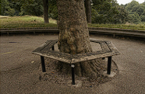
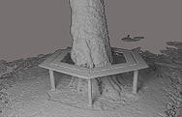
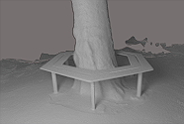
Model Overview – GS: 2DGS
Ground Truth
3DGS
2DGS
notable problem: oversmoothing leads to loss of details

Slide 12
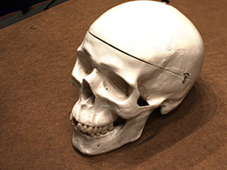
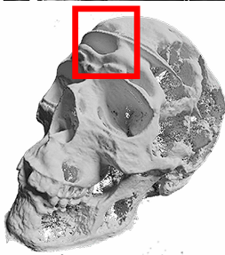
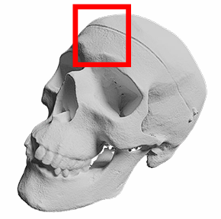
Model Overview – GS: RaDe-GS
main goal: improve geometric reconstruction details
main idea: use rasterized approach to render depth map and surface normal maps of 3D Gaussians
Closed-form solution in calculating intersection between light ray and splats
Similar efficiency, more detailed results and clear geometry
3DGS
RaDe-GS
Notes:
RaDe-GS
Main goal of RaDe-GS is to improve geometric reconstruction details.
Main idea – instead of creating meshes from the point cloud or using volumetric representations, directly rasterize the 3D Gaussians to accurately capture details.
How depth is calculated: use ray-splat intersection and calculate until the point the ray is supposed to terminate per pixel.
- To calculate the depth in a pixel, for example, we take a look at the multiple splats that “occupy” the pixel and average it out
- weights are based on the visibility of the gaussian itself and location of the centerpoints of the Gaussians
Limitations: may not perform well in noisy situations since there is no noise filtering strategies, struggle with transparency

Slide 13


Model Overview – GS: GS2Mesh
COLMAP
3DGS
stereo depth estimation
Mesh
main idea: extract depth and geometry through pre-trained stereo-matching model
After 3DGS step: generate stereo-calibrated images from the training image inputs and apply stereo matching algorithm for depth (DLNR model).
Mesh extraction using TSDF and marching cubes algorithm
Notes:
GS2Mesh
General pipeline:
- set of input images,
- inputted to COLMAP,
- then to 3DGS,
- then stereo depth estimation: GS2Mesh generates novel stereo views of the poses according to training images:
----left image taken directly from training images
----right image generated by shifting the left image with a horizontal baseline such that the pair is stereo calibrated (calibrated as if we’re seeing it from two eyes)
----next, the calibrated images are inputted to stereo matching algorithm to determine depth
Mesh extraction with TSDF (Truncated Signed Distance Function) and marching cubes algorithm
TSDF:
- SDF function tells you how far any point in space is from surface of an object
- point outside object is positive, point inside object negative
TSDF: limit ranges that we care about (objects that are too close or only visible from one of the cameras are masked out)
Marching cubes algorithm:
- basically: map out boundaries in the data, how a surface crosses a cube
- process each cube in the data and check it against a threshold value, draw mesh based on the value
- simplified: imagine a cheese, map out squares in the cheese. To determine where the holes are in the cheese, take small square chunks of the cheese and check for the hole

Slide 14
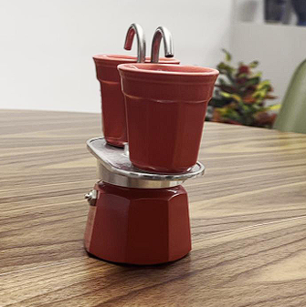
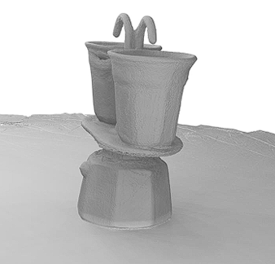
Model Overview – GS: GS2Mesh
Limitations: retains weakness of 3DGS (noisy results), TSDF is inefficient for larger inputs (exponential amount of points to check), inefficient rendering

Slide 15
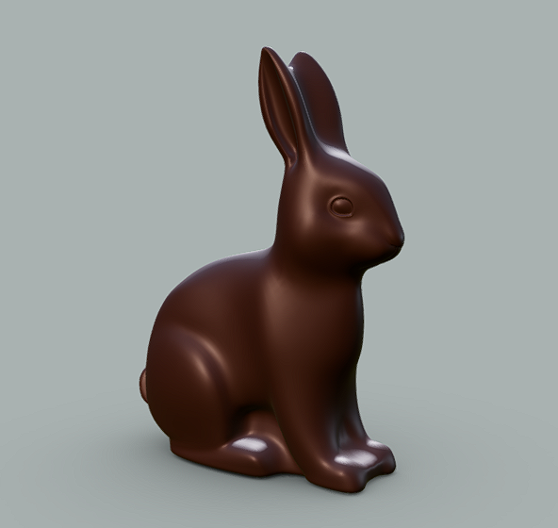
Methodology – Dataset Creation
model: chocolate bunny
preprocessing: adding lighting and creating script for input creation
Notes:
Need to choose a model in order to test the chosen GS and MDE models
Reason of choice: model is simple, does not have a lot of features or colors
Reason of using synthetic data: same with DepthAnything v2: can be fully controlled, GT values are easy to extract
-drawbacks from this: model is weirdly shaped not like a normal bunny, so it may present some challenge, environment not realistic, not ideal for some models since they are trained on real-life data

Slide 16
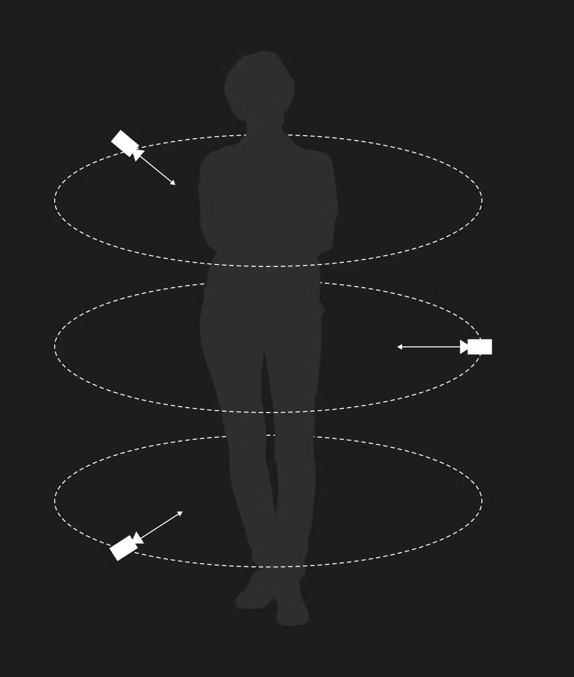
Methodology – Dataset Creation
Extraction of Synthetic Depth Data (GT data) and input dataset creation from model
Systematically capture model from multiple angles with Python script.
output: set of 120 images (6 different height values, 20 images per height value) complete with camera poses and depth data
Notes:
GS needs input of images, camera poses, direction (which is what we generate with this script)
Also save depth data as GT data for evaluation
Model Capture steps:
1. define two points, bottom left and top right as if the object is a cube
2. calculate minimum distance such that the longest “side” of the object is captured, define “edges” of the object
- alpha = math.sin(FoV)
- maxDist = Multiplier * (maxRad / alpha) * math.sqrt(1 - \(alpha * alpha))
- FoV = 50.0
3. simulate an orbit with transformations to the camera (rotate around y and z axis) by amount specified by the step, save data at every step

Slide 17
Methodology – Dataset Creation
code adaption:
https://github.com/evelynsidarta/gaussian-splatting-thesis
training:
10,000 iterations each, depth extraction with the help of 2DGS rendering script
Notes:
Code adaption:
- most of the pipelines only accept SfM inputs from COLMAP, adjust code to accept synthetic data instead since we already have all the required inputs
- most changes to dataset_reader.py files
Training: 10k iterations for each models, depth extracted with the help of the 2DGS rendering script since it conveniently outputs the rendered data’s depth map from the original training camera poses as byproduct

Slide 18
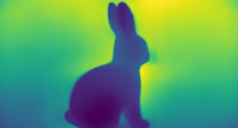
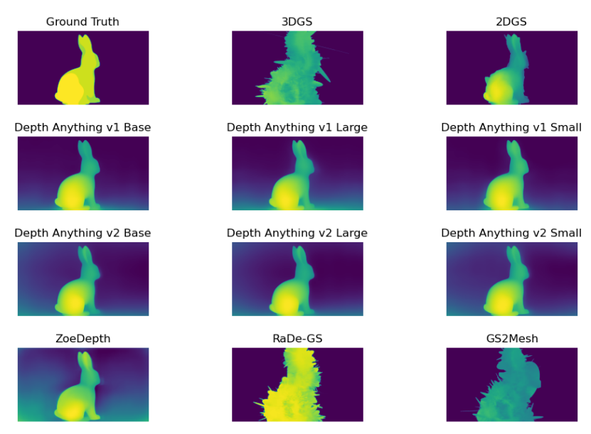
Methodology – Postprocessing
All depth map outputs converted into inverted depth map for better numerical stability: infinite background = 0
normalization using min-max scaling: range [0, 1]
Notes:
Postprocessing is done to “correct” some values of the outputs of each model pipeline
Also: Chocolate bunny has no background -> infinite length induce instability during evaluation if not corrected
Mostly: conversion into inverted depth maps: infinite length have value 0 and nearer objects have higher values
- x’ = x / (1+error)
Min-max normalization: x’ = (x – xmin) / (xmax – xmin)

Slide 19
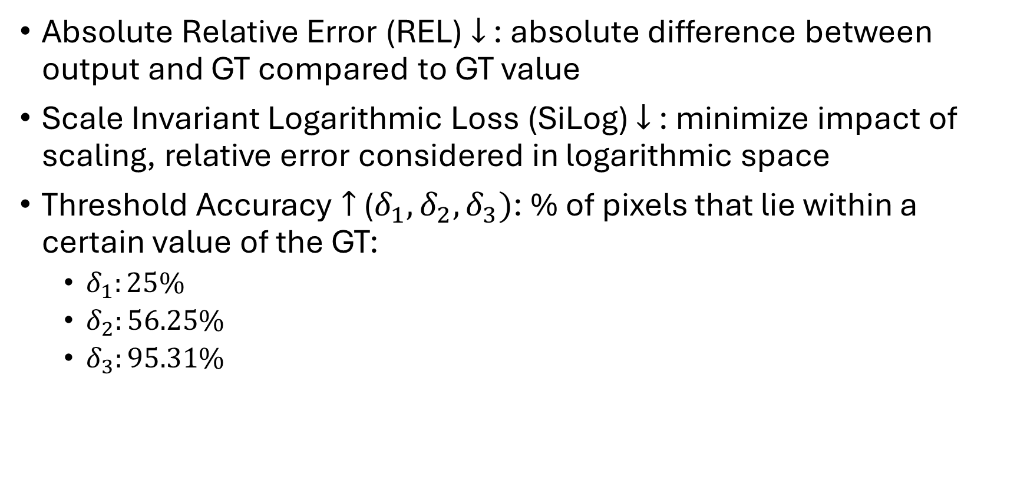
Methodology – Evaluation Metrics
Absolute Relative Error (REL) $↓$ : absolute difference between output and GT compared to GT value
Scale Invariant Logarithmic Loss (SiLog) $↓$ : minimize impact of scaling, relative error considered in logarithmic space
Threshold Accuracy $↑$ ($δ_{1}, δ_{2}, δ_{3})$: % of pixels that lie within a certain value of the GT:
$δ_{1}:25\%$
$δ_{2}:56.25\%$
$δ_{3}:95.31\%$
Notes:
1. Absolute Relative Error simply measures the absolute difference between the model output and the GT value when compared to the GT value (so, magnitude of error), lower is better
2. Scale Invariant Logarithmic Loss error minimizes the impact of scaling, considers relative error in logarithmic space
- Done because depth estimation is an ill-posed task, meaning there is an infinite number of possible scaling in a problem and they all represent a “correct” solution (which is why measuring absolute distance is very hard to do)
- Lower is better
3. Threshold accuracy: % of pixels which has a value that lie within a certain range when compared to the GT
- e.g. \delta_1 measures the % number of pixels whose value lie within 25% of the GT value

Slide 20
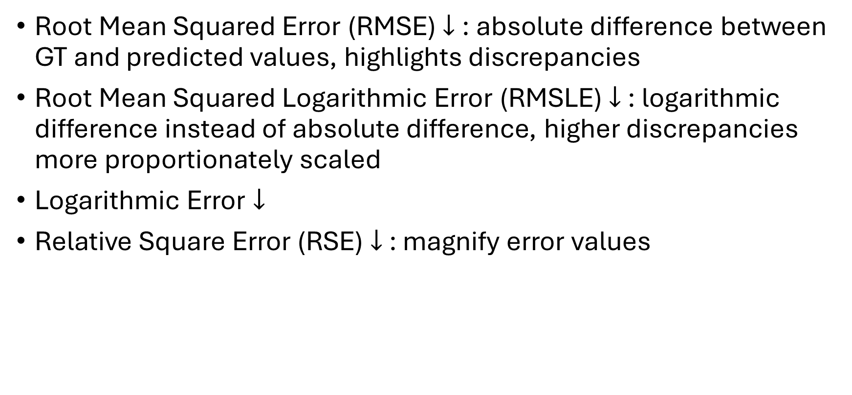
Methodology – Evaluation Metrics
Root Mean Squared Error (RMSE) $↓$: absolute difference between GT and predicted values, highlights discrepancies
Root Mean Squared Logarithmic Error (RMSLE) $↓$ : logarithmic difference instead of absolute difference, higher discrepancies more proportionately scaled
Logarithmic Error $↓$
Relative Square Error (RSE) $↓$ : magnify error values
Notes:
4. RMSE: describes absolute difference between GT values compared to the predicted outcome. Here, discrepancies are highlighted due to squaring operation
5. RMSLE: logarithmic difference instead of absolute difference, higher discrepancies are more proportionately scaled due to the logarithmic scale
6. Log error: logarithmic difference between values, does not highlight discrepancies
7. Relative square error: works similarly to REL, but error values are magnified more due to the squaring operation

Slide 21
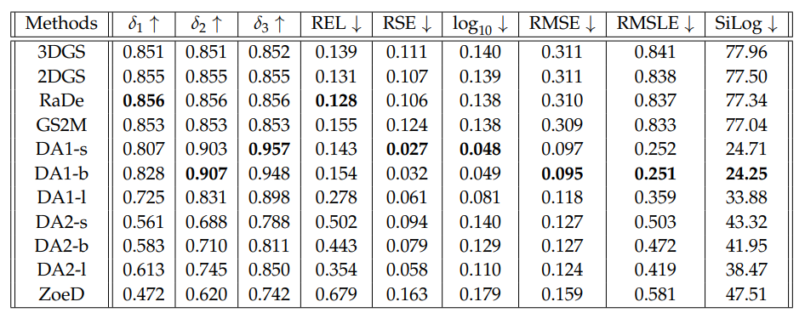
Evaluation – Statistical Analysis Results

Slide 22
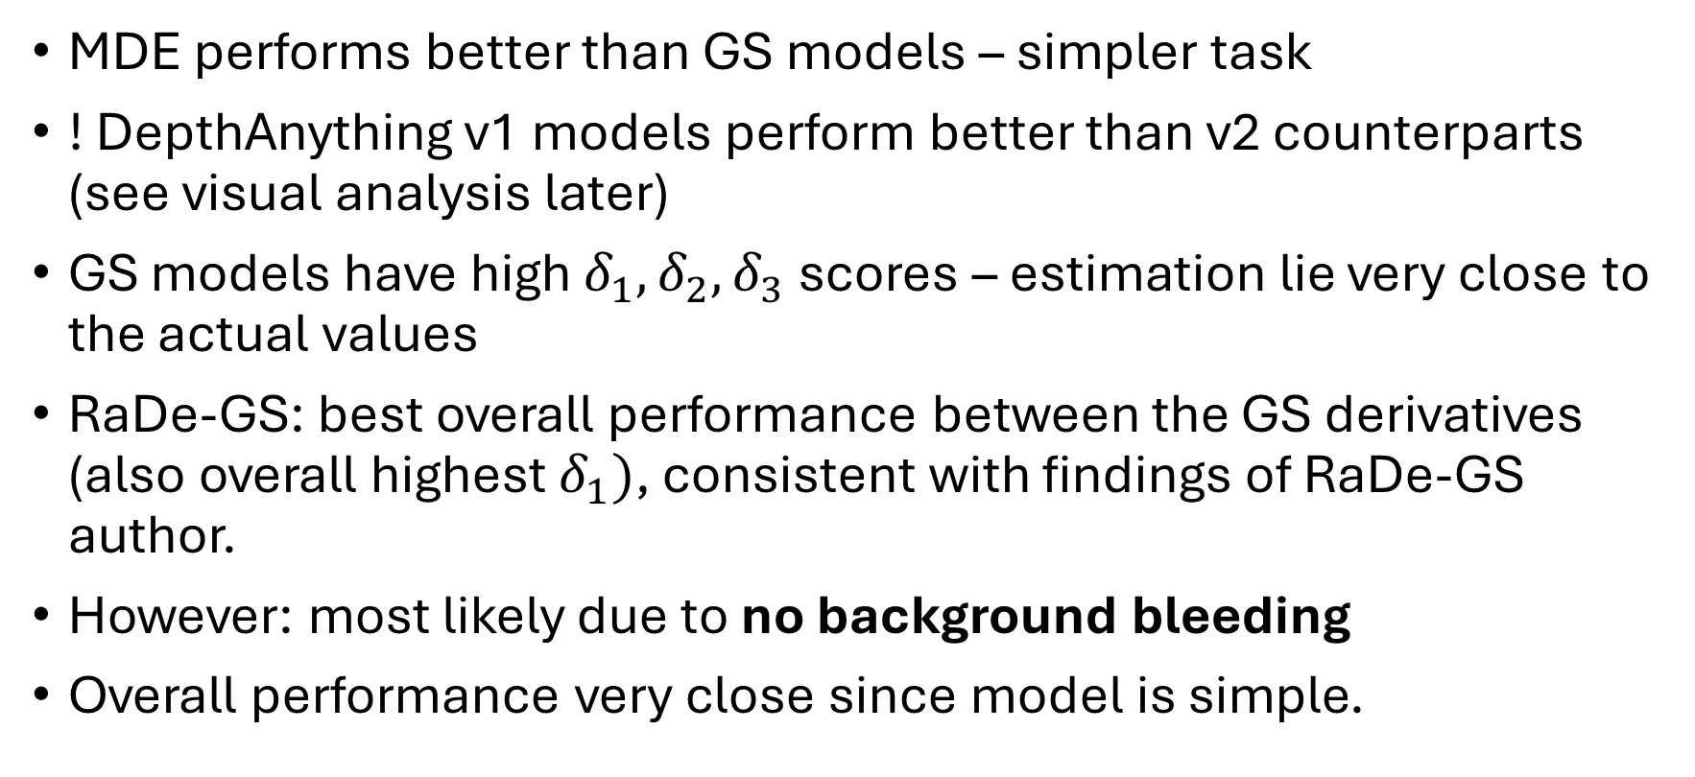
Evaluation – Observations
MDE performs better than GS models – simpler task
! DepthAnything v1 models perform better than v2 counterparts (see visual analysis later)
GS models have high $δ_{1}, δ_{2}, δ_{3}$ scores – estimation lie very close to the actual values
RaDe-GS: best overall performance between the GS derivatives (also overall highest $δ_{1})$, consistent with findings of RaDe-GS author.
However: most likely due to no background bleeding
Overall performance very close since model is simple.
Notes:
- MDE models seem to perform better than GS models overall: lower delta 1, 2, 3 values but if we ignore scaling (as we can see with SiLog) values, MDE models are more accurate
Surprising: DepthAnything v1 > v2 (explained later in visual analysis): may be due to v2 trying to produce sharper and more realistic details, while v1 models are overall “flatter” with less details
----Perform well with this data simply because the chocolate bunny in our GT have very flat values (not a realistic bunny) while DepthAnything v2 try to give more curves
GS models have high delta 1, 2, 3 scores: estimation lie very close to actual values
RaDe-GS seem to have overall best performance between all the GS models – consistent with RaDe-GS paper
However (will see later) this is probably most likely due to no background bleeding happening in GS models
Overall performance between models very close to each other

Slide 23
Evaluation – Visual Analysis
Overall smooth shape
Trying to create a bunny, not flat like the original chocolate bunny model
Background bleeding – weak statistical performance due to this

Slide 24
Evaluation – Visual Analysis
Large model more detailed (see ear splits)
Small and base models do well on statistical analysis due to “flatter” look

Slide 25
Evaluation – Visual Analysis
Overall a lot sharper than v1
Ear splits and leg splits apparent even in small model
However: oversmoothing

Slide 26
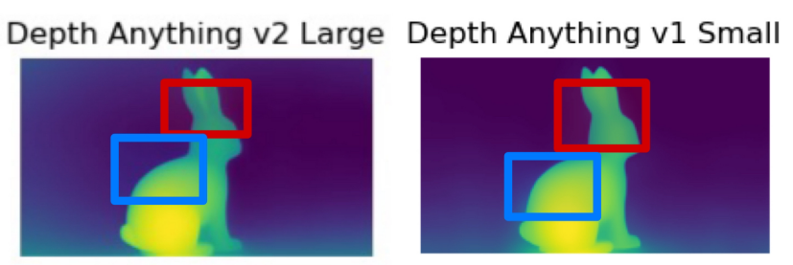
Evaluation – Visual Analysis
v2 models are much sharper (see ear)
v1 models are flatter in comparison – better statistical result since bunny is flat (see wider “yellow” area)

Slide 27
Evaluation – Visual Analysis

Slide 28
Evaluation – Visual Analysis
GT image possess very basic form, very flat
GS models much rougher: elliptical shape of the Gaussians
3DGS very rough, general shape clear, but details missing
Orientation of the bunny unclear, some splats stick out at a weird angle

Slide 29
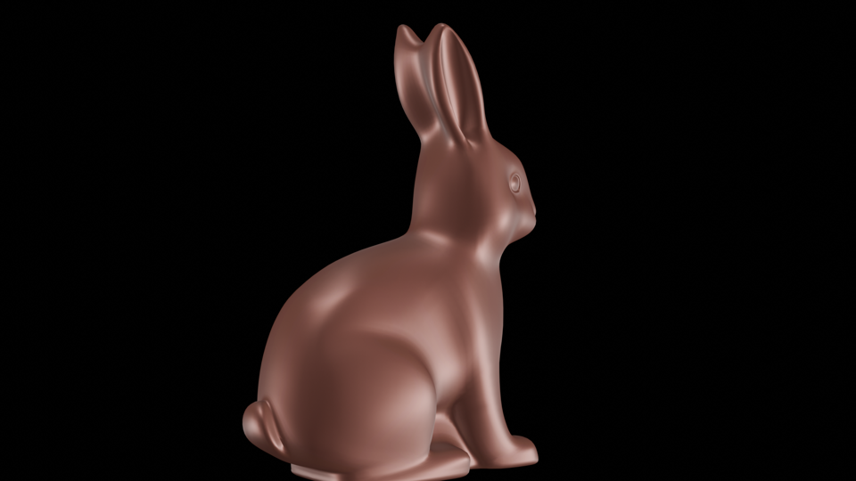
Evaluation – Visual Analysis
2DGS: overall best visuals
Ear folds, legs, and tail distinguishable, orientation also obvious
Smooth geometry not a problem since base GT model is not too detailed
Oversmoothing – problem in statistical analysis when compared to RaDe-GS

Slide 30
Evaluation – Visual Analysis
GS2Mesh – weird splats on some places – same as 3DGS
Outline of bunny can be observed but details are entirely gone
RaDe-GS – does not perform as well in visual analysis compared to in statistical analysis
However: overall maintain flatter look – good score statistically

Slide 31
Limitations – Current State-of-Art Methods
MDE models struggle from background bleeding, not used to dealing with unrealistic situations – poor statistical results even though performance is excellent visually
GS models suffer from awkward shape of Gaussians: less smooth even though overall shape retained. Also more noisy due to density of Gaussians.
Low opacity Gaussians still have depth values that needed to be considered for evaluation.

Slide 32
Suggestions – Further Improvements
Using more variative models in the future
Also incorporate more realistic data (not just synthetic models with purely silent backgrounds)
Somehow consider transparency of the Gaussians when looking at the depth map

